Slide 1
Local Computation Algorithms – a short survey
Shai Vardi, Weizmann Institute of Science
Sublinear Algorithms Workshop, January 9, 2016

Slide 2
Example: Maximal Weight Forest (MWF)
Given a graph $G,$ a maximal weight forest is a forest of maximal weight out of all possible forests.
(If all edge weights are positive and $G$ is connected, it will be a tree.)

Slide 3
An example: MWF
0.4
4
0.1
6
5
8
0.3
0.2
7
3

Slide 4
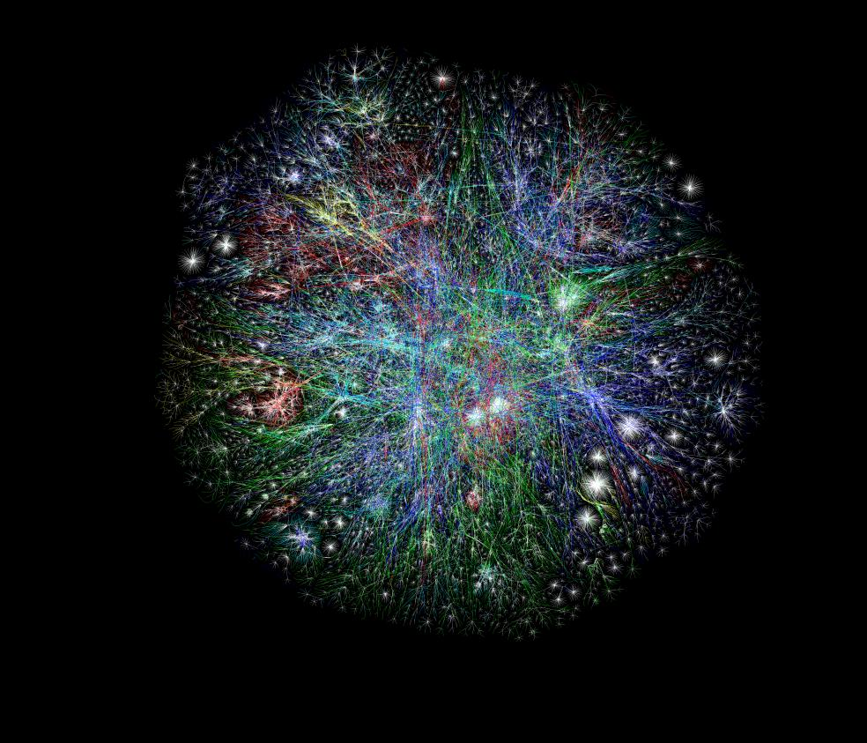
Motivation
0.4
4
0.1
Is $e$ in MWF?
6
5
8
0.3
0.2
7
3

Slide 5
Local Computation Algorithms (LCAs)
Give consistent replies to queries regarding parts of a solution to a problem.
Require sublinear space and time per query.
(With high probability every query is answered quickly.)

Slide 6
LCA for MWF
$$?$$
0.4
4
0.1
$$?$$
6
5
8
0.3
0.2
7
$$?$$
3

Slide 7
LCAs
In other words, we want it to seem to the user(s) that there is some single solution that we are querying quickly.

Slide 8
A Good LCAs for MWF
0.4
4
0.1
$$?$$
no
6
5
8
0.3
0.2
7
3
$$?$$
yes

Slide 9
Bad LCAs for MWF
3
$$?$$
4
$$?$$
yes
$$?$$
yes
no
5
3
$$?$$
yes
0.3
3

Slide 10
When LCAs might be useful
Expensive probes, only a fraction of the solution will actually be needed.
Different processors accessing the same database, all requiring the same solution.
LPs with an exponential number of constraints.
…

Slide 11
LCAs
Fast Local Computation Algorithms - Rubinfeld, Tamir, V, Xie - ICS 2011
Local Reconstruction (e.g., Saks and Seshadhri)
LDCs (e.g., Katz and Trevisan)
PageRank
…

Slide 12
The Parnas-Ron reduction [‘07]
If there is a distributed algorithm that computes a solution to a problem in $t$ rounds, there is an LCA for the same problem that requires $O(∆^{t})$ probes to the graph.

Slide 13
LCAs for MIS, Maximal Matching, etc.
Fast Local Computation Algorithms - Rubinfeld, Tamir, V, Xie - ICS 2011
Space-Efficient LCAs - Alon, Rubinfeld, V, Xie - SODA2012
Converting Online Algorithms to LCAs - Mansour, Rubinstein, V, Xie - ICALP 2012

Slide 14
LCAs for MIS, Maximal Matching, etc.
High level idea (based on Nguyen and Onak, 2008)
Generate a random permutation/order on the vertices (on the fly).
Simulate the online greedy algorithm on this order.
40
81
$$?$$
12
68
31
no
21
149
55

Slide 15
Summary of Results
Challenges:
Bounding the number of probes (and running time) with high probability (not just in expectation)!
The random order has to be the same for every query.
Results:
Number of probes = $O(\log{n)}$ w.h.p. for bounded degree graphs. (Exponential dependence on $∆$).
Use a random seed of length $O(\log^{3}n)$.

Slide 16
Seed Length
Generate a random number from $1,…{,n}^{4}$. This can be done with seed $O(\log^{3}n)$.
The probability of a collision is $O\left(1/{n^{2}}\right).$
If there is a collision, either:
Return “fail”.
Continue as planned, breaking ties arbitrarily (violating the running time promise).
40
81
12
68
31
21
149
55

Slide 17
LCAs for MIS, Maximal Matching, etc.
Deterministic Stateless Centralized Algorithms for Bounded Degree Graphs - Even, Medina, Ron - ESA 2014
Used distributed coloring to generate an acyclic orientation to:
Reduce the number of probes to $O\left(\log^{∗}n\right)$ (still an exponential dependence on $∆$),
Give deterministic LCAs.

Slide 18
Coloring for ordering
Color deterministically using, say, $∆^{2}$ colors.
Need to look at most at a ball of radius $∆^{2}$ - $∆^{{(∆}^{2})}$vertices.
4
6
1
5
3
2
3
5

Slide 19
LCAs for MIS, Maximal Matching, etc.
Deterministic Stateless Centralized Algorithms for Bounded Degree Graphs - Even, Medina, Ron - ESA 2014
Used distributed coloring to generate an acyclic orientation to:
Reduce the number of probes to $O\left(\log^{∗}n\right)$ (still an exponential dependence on $∆$),
Give deterministic LCAs.
Use distributed coloring techniques of Linial and Panconessi and Rizzi to color using$\tilde{O}(∆^{2})$ colors.

Slide 20
LCAs for MIS, Maximal Matching, etc.
What about non-constant degrees?
New Techniques and Tighter Bounds for LCAs - Reingold, V – 2015

Slide 21
$d$-light graphs
balls
bins
Include the following:
The graph created when each ball chooses $d$ bins uniformly at random.
Random graphs.
Graphs of bounded degree.

Slide 22
Reingold, V construction
Generate a random number from $1…O(d)$.
7
8
$$?$$
3
7
3
2
9
8
Seed size: $O(log⁡n)$.
Number of probes$O(log⁡n)$ w.h.p. on $d$-light graphs.

Slide 23
LCAs for MIS, Maximal Matching, etc.
What about non-constant degrees?
New Techniques and Tighter Bounds for LCAs - Reingold, V – 2015
LCAs for Graphs of Non-Constant Degrees - Levi, Rubinfeld, Yodpinyanee - SPAA 2015
MIS, MM in $2^{(polylog ∆)}polylog n$on general graphs.

Slide 24
Impossibility Results
4
3 or 1
6
7
5
It is impossible to get an exact maximal weighted forest in sublinear time…
8
9
$$?$$
2

Slide 25
Lower bounds
$Ω\left(\log^{∗}n\right)$for 3-coloring a ring (and hence MIS, MM, etc.)
Ongoing work with Uriel Feige and Boaz Patt-Shamir (unpublished).
Discovered independently by Göös et al. (unpublished).

Slide 26
Probes
The following are single probes to the graph:
Asking a vertex for its degree.
Asking a vertex for the ID of its i^{th} neighbor.
Asking an edge for its weight.

Slide 27
Impossibility Results
8
4
Query: vertex 4
Degree of 4?
ID of right neighbor of 4?
Degree of 9?
9
9

Slide 28
Lower bounds
$Ω\left(\log^{∗}n\right)$for 3-coloring a ring (and hence MIS, MM, etc.)
Reduction from distributed lower bounds (Linial).
Ongoing work with Uriel Feige and Boaz Patt-Shamir (unpublished).
Discovered independently by Göös et al. (unpublished).
No $o(\sqrt{n})$-probe LCA to approximate Vertex Cover within $\left(1+ε\right)$.
Reduction from property testing lower bounds (Goldreich Ron, 2002).
Learning and Inference in the Presence of Corrupted Inputs –
Feige, Mansour and Schapire - COLT 2015

Slide 29
Constant-Time LCAs
Constant-Time LCAs – Mansour, Patt-Shamir, V - WAOA 2015
$(1−ε)$ – approximation LCAs for
maximal weighted forest in $∆^{O(1/ε)}$.
Contrast with Local Algorithms for Sparse Spanning Graphs – Levi, Ron, Rubinfeld – APPROX-RANDOM 2014

Slide 30
Attempt: Simulate Borůvka
0.4
0.3
0.1
9
7
5
8
4
0.2
6
3

Slide 31
One round of Borůvka
Weight of MWF: 9+8+7+6+5+4+3 = 42
Weight of solution: 9+8+7+5 = 29
0.4
0.3
0.1
9
7
5
8
4
0.2
6
3

Slide 32
One round of Borůvka
Claim: The first round of Borůvka’s algorithm gives a ½ -approximation to the MWF.
Proof outline: At least $n/2$ edges were accepted (each vertex accepted exactly one), and we can charge unaccepted edges to accepted ones.

Slide 33
The ½-approximation LCA
When queried on an edge, check whether it is the heaviest edge of either of its vertices. If yes, accept. Otherwise reject.
Number of probes: $2 + 2d$.
Consistent with the (unique) solution of the first round of Borůvka.

Slide 34
Size of CCs can grow exponentially
0.4
0.3
0.1
9
7
5
8
4
0.2
6
3

Slide 35
The (1-$ε$)-approximation LCA
Borůvka is difficult to simulate/analyze once we go beyond one round, so we describe a worse parallel algorithm for MWF. The new algorithm can take much longer to find a MWF, but is much easier to analyze.

Slide 36
High Level
9
5
More graph
4
0.2
8
7
6
0.1

Slide 37
Some Applications
Economics and Computation –
Local Computation Mechanism Design-
Hassidim, Mansour, V - EC 2014, TEAC 2016
Learning –
Learning and Inference in the Presence of Corrupted Inputs -
Feige, Mansour and Schapire - COLT 2015
Distributed Algorithms –
Distributed Maximal Matching in Bounded Degree Graphs -
Even, Medina, Ron - IDCDN 2015

Slide 38
Open Problems
$Polylog(n)$LCAs for graphs with degree $θ(\log{n).}$
More lower bounds.
Connections to other models (e.g. distributed CONGEST).
Connection to robust networks.

Slide 39
Thank you!

