Slide 1
Testing the Cluster Structure of Graphs Christian Sohler joint work with Artur Czumaj and Pan Peng

Slide 2
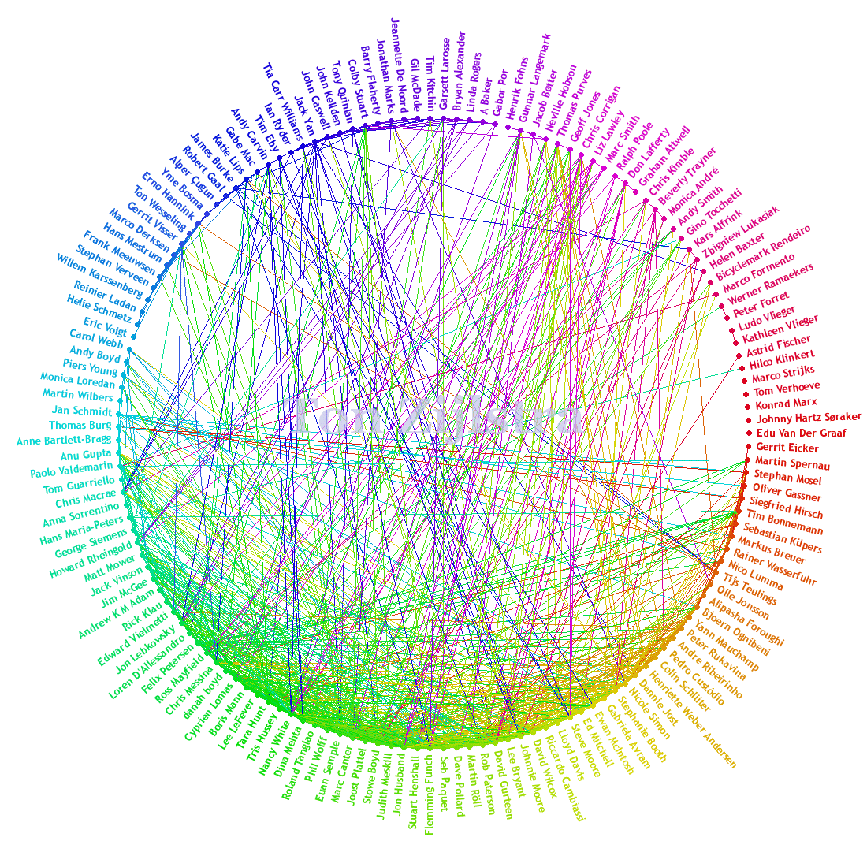
Very Large Networks
Examples
Social networks
The World Wide Web
Cocitation graphs
Coauthorship graphs
Data size
GigaByte upto TeraByte (only the graph)
Additional data can be in the Peta-Byte range
Source: TonZ; Image under Creative Commons License

Slide 3
Information in the Network Structure
Social network
Edge: Two persons are „friends“
Well-connected subgraph: A social group
Cocitation graphs
Edge: Two papers deal with a similar subject
Well-connected subgraph: Papers in a scientific area
Coauthor graphs
Edge: Two persons have worked together
Well-connected subgraph: Scientific community

Slide 4
How can we extract this information?
Objective
Identify the well-connected subgraphs (clusters) of a huge graph
Problem
Classical algorithms require at least linear time
Might be too large for huge networks
Our approach
Decide, if the graph has a cluster structure or is far away from it
If yes, get a representative vertex from each (sufficiently big) cluster
Running time sublinear in the input size

Slide 5
Formalizing the Problem – The Input
Input Model
Undirected graph G=(V,E) with vertex set {1,…,n}
Max. degree bounded by constant D
Graph is stored in adjacency lists
We can query for the i-th edge incident to vertex j in O(1) time
Property Testing [Rubinfeld, Sudan, 1996, Goldreich, Goldwasser, Ron, 1998]
Formal framework to study sampling algorithms for very large networks
Bounded degree graph model [Goldreich, Ron, 2002]

Slide 6
Formalizing the Problem – Cluster Structure
Definition
The conductance Φ(C,V-C) is defined as
The conductance Φ_{G}(G) of G is min_{C:|C|≤|V|/2} Φ(C,V-C)
Definition
A subset C⊆V is called (Φ_{in}, Φ_{out} )-cluster, if
Φ_{G}(G[C]) ≥ Φ_{in}
Φ(C, V-C) ≤ Φ_{out}
Definition
A partition of V into at most k (Φ_{in}, Φ_{out} )-clusters is called (k, Φ_{in}, Φ_{out} )-clustering

Slide 7
Formalizing the Problem
Our Objective
Develop a sampling algorithm that (a) accepts with probability at least 2/3, when the input graph is a (k, Φ_{in}, Φ_{out} )-clustering (b) rejects with probability at least 2/3, if the input graph differs from every (k, Φ_{in}*, Φ_{out} *)-clustering in more than εDn edges
The number of samples taken (and running time) of the algorithm should be as small as possible

Slide 8
Random Walks, Stationary Distributions & Convergence
Random Walk
In each step: move from current vertex v to a neighbor chosen uniformly at random
Convergence
If G is connected and not bipartite, a random walk converges to a unique stationary distribution
Pr[Random Walk is at vertex v] ∼ deg(v)

Slide 9
Random Walks, Stationary Distributions & Convergence
Lazy Random Walk
In each step: - Probability to move from current vertex v to neighbor u is 1/(2D) - stays at v with remaining probability
Stationary distribution is uniform
Rate of Convergence
Can be expressed in terms of the conductance of G or the second largest eigenvalue of the transition matrix
O(log n) steps, if G is a (1, Φ_{in}, Φ_{out} )-clustering for constant Φ_{in}

Slide 10
Previous Work
k=1: Testing Expansion ((1, Φ_{in}, Φ_{out} )-clustering)
[Goldreich, Ron, 2000] introduced an algorithm based on collision-statistics of random walks
They conjectured the algorithm to accept in O*(√n) running time every Φ-expander and reject every expander, which differs in more than εDn edges from a Φ*-expander
First proof with a polylogarithmic gap (in n) between Φ and Φ* [Czumaj, Sohler, 2010]
Improvement of parameters to constant gap (with running time O*(n^{1/2+δ})) [Nachmias, Shapira, 2010; Kale, Seshadri 2011]
O* assumes all input parameters except n to be constant and supresses logarithmic factors

Slide 11
Previous Work
TestingExpansion(G,ε)
Sample Θ(1/ε) vertices uniformly at random
For each sample vertex do
- Perform O*(√n) lazy random walks of length Θ*(log n) from each vertex - if the number of collisions among end points is too high then reject
accept
Analysis
If G is a (1, Φ_{in}, Φ_{out} )-clustering, then a lazy random walk converges quickly to the uniform distribution
Let p(v) be the distribution of the end points of a random walk starting at v
||p(v)||² is the expected number of collisions
The uniform distribution minimizes ||p(v)||²

Slide 12
Previous Work
TestingExpansion(G,ε)
Sample Θ(1/ε) vertices uniformly at random
For each sample vertex do
- Perform O*(√n) lazy random walks of length Θ*(log n) from each vertex - if the number of collisions among end points is too high then reject
accept
Analysis
If G is far away from a (1, Φ_{in}, Φ_{out} )-clustering, then the ||p(v)||² is large

Slide 13
Testing k-Clusterings
Main Idea
When increasing the length of the random walks, two random walks starting from the same cluster should eventually have almost the same distribution (and this is almost uniform on the cluster)
Two random walks starting in different cluster should have different distributions
Obstacles
We cannot test closeness to the uniform distribution since we don‘t know the clusters
We do not compare stationary distributions

Slide 14
The Algorithm
ClusteringTest
Sample set S of s vertices uniformly at random
For any v∈S let p(v) be the distribution of end points of a random walk of length Θ*(log n) starting at v
for each pair u,v∈S do
if p(u) and p(v) are close then add an edge (u,v) to the „cluster graph“ on vertex set S
accept, if and only if the cluster graph is a collection of at most k cliques

Slide 15
Completeness
Lemma (informal)
Let p(v) denote the distribution of the end point of a random walk of given length. For our choice of parameters, if G is a (k, Φ_{in}, Φ_{out} )-clustering then (a) for most pairs u,v are from the same cluster C, ||p(v)-p(u)||²≤1/(4n), (b) for most pairs u,v are from different clusters, ||p(v)-p(u)||² > 1/n.

Slide 16
Completeness
Lemma (informal)
Let p(v) denote the distribution of the end point of a random walk of given length. For our choice of parameters, if G is a (k, Φ_{in}, Φ_{out} )-clustering then (a) for most pairs u,v are from the same cluster C, ||p(v)-p(u)||²≤1/(4n), (b) for most pairs u,v are from different clusters, ||p(v)-p(u)||² > 1/n.
Consequence
If we can estimate the distance of two distribution in sublinear time up to an l₂-error of 1/(4n), then ClusteringTest accepts any (k, Φ_{in}, Φ_{out} )-clustering.
2

Slide 17
Completeness
Lemma (informal)
Let p(v) denote the distribution of the end point of a random walk of given length. For our choice of parameters, if G is a (k, Φ_{in}, Φ_{out} )-clustering then (a) for most pairs u,v are from the same cluster C, ||p(v)-p(u)||²≤1/(4n), (b) for most pairs u,v are from different clusters, ||p(v)-p(u)||² > 1/n.
Consequence
If we can estimate the distance of two distribution in sublinear time up to an l₂-error of 1/(4n), then ClusteringTest accepts any (k, Φ_{in}, Φ_{out} )-clustering.
Can be done using previous work of [Batu et al.,2013] or [Chan, Diakonikolas, Valiant, Valiant, 2014]
2

Slide 18
Soundness
Lemma (informal)
If G differs in more than εdn edges from a (k, Φ_{in},*, Φ_{out} *)-clustering then one can partition V into k+1 subsets C₁,…,C_{k+1} of size Ω∗(n) such that Φ(C_{i}, V-C_{i}) is small for all i.
Example: ε-far from (2, Φ_{in},*, Φ_{out} *)-clustering

Slide 19
Soundness
Lemma (informal)
If G differs in more than εdn edges from a (k, Φ_{in},*, Φ_{out} *)-clustering then one can partition V into k+1 subsets C₁,…,C_{k+1} of size Ω∗(n) such that Φ(C_{i}, V-C_{i}) is small for all i.
Example: ε-far from (2, Φ_{in},*, Φ_{out} *)-clustering
Sample will hit all k+1 subsets

Slide 20
Soundness
Lemma (informal)
If G differs in more than εdn edges from a (k, Φ_{in},*, Φ_{out} *)-clustering then one can partition V into k+1 subsets C₁,…,C_{k+1} of size Ω∗(n) such that Φ(C_{i}, V-C_{i}) is small for all i.
Example: ε-far from (2, Φ_{in},*, Φ_{out} *)-clustering
Distance between vertices from different clusters is big

Slide 21
Summary
Theorem
Algorithm ClusteringTester accepts every (k, Φ_{in}, Φ_{out})-clustering with probability at least 2/3 and rejects every graph that differs in more than εdn edges from every (k, Φ_{in}*, Φ_{out} *)-clustering with probability at least 2/3, where Φ_{out} =O_{d,k} (ε⁴ Φ_{in}²/log n) and Φ_{in}* = Θ_{d,k} (ε⁴ Φ_{in}²/log n).
The running time of the algorithm is O*(√n).

Slide 22
Thank you!

