Slide 1
Towards Resistance Sparsifiers
 | Michael Dinitz (Johns Hopkins)
Joint work with | Tal Wagner (MIT)
 | Robert Krauthgamer (Weizmann)

Slide 2
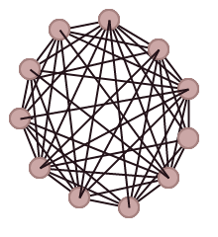
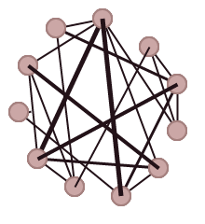
Graph Sparsification
Input: Dense graph G
Goal: Sparse (weighted) subgraph H that approximately preserves some properties of G
Examples:
Shortest paths (“spanners”) [Peleg-Schäffer’89]
Cut values (“cut sparsifiers”) [Benczúr-Karger’96]
Eigenvalues (“spectral sparsifiers”) [Spielman-Teng’04]
Resistance distances

Slide 3
Graph Metrics
Sometimes shortest-path distance is not right notion of distance in graph
Some applications: want “distance” to measure “similarity” or “closeness”
Take “width” into account
x
y
x
y

Slide 4
Graph Metrics
But don’t want just the width
x
y
x
y

Slide 5
Resistance Distance
Want a single metric combining shortest-path distance (“length”) and “width” of connection
Effective Resistance:
Each edge is a 1 ohm resistor, insert 1 amp of electrical current at x, remove from y
V = IR and I = 1, so voltage drop between x and y is “effective resistance”
Edge weight w: resistance 1/w
Old but still amazing theorem: effective resistance = commute time of random walk (up to scaling).
x
y
~
x
y
~

Slide 6
Resistance Distance
Equivalent views:
Electric voltage difference
Random walk
Random spanning tree
Widely used in applications
Closely tied to algebraic properties of graph:
v
u
~

Slide 7
Resistance Sparsifiers
Want: ε-resistance sparsifier
Subgraph H of G such that (1-ε) RG(u,v) ≤ RH(u,v) ≤ (1+ε) RG(u,v)
Can we construct resistance sparsifiers with few edges?
Yes: Spectral sparsifiers are resistance sparsifiers!
Size (#edges): O(n/ε²) [Batson-Spielman-Srivastava’09]
Can we do better? O(n/ε)?

Slide 8
Resistance Sparsifiers
No: Know matching lower bound for spectral sparsifier.
Preserving eigenvalues of Kn requires Ω(n/ε²) edges [BSS’09]
But resistance sparsifiers are weaker
First observation: Kn no longer a tight example
Resistance sparsifiers have size O(n/ε)
Consequence of [von Luxburg-Radl-Hein’10]
Kn only known tight example for spectral sparsifiers!
Conjecture: All graphs admit an ε-resistance sparsifier with O(n/ε) edges

Slide 9
The vLRH Bound
Expander: any graph G where
[von Luxburg, Reidl, Hein]: on an expander, effective resistance is essentially determined by degrees.
Second smallest eigenvalue of normalized Laplacian

Slide 10
The vLRH Bound
Applied to G=Kn:
Initially, RG(u,v) = 2/n for all u,v
Set H to be 1/ε-regular expander with weights εn
So
ε-resistance sparsifier with O(n/ε) edges!
Note: does not work to sample each edge independently with probability 1/(εn)
Would need probability 1/(ε²n), and then would get full spectral sparsifier

Slide 11
Results
Conjecture true for dense regular expanders:
Theorem 1: Every Ω(n)-regular expander has a ε-resistance sparsifier of size Õ(n/ε).
So generalized from complete graph to dense regular expanders
Not much of a generalization, still surprisingly difficult!

Slide 12
Results
Underlying structural result:
Theorem 2: Every Ω(n)-regular expander contains a polylog(n)-regular expander as a subgraph.
Implies Theorem 1 by vLRH:
Use Theorem 2 1/ε times to get an Õ(1/ε)-regular expander
Reweight edges so each node has same total weight as in input graph
Parameters work out
Possibly of independent interest?

Slide 13
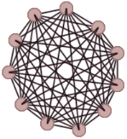
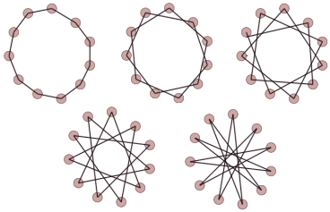
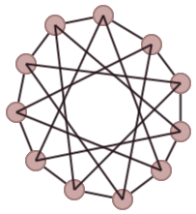
Algorithm
Input: Dense regular expander G
Goal: Find sparse regular expander subgraph H
Algorithm:
Decompose G into disjoint Hamiltonian cycles or perfect matchings
Choose a uniformly random subset of them to form H
Analysis: …

Slide 14
Analysis

Slide 15
The Cut-Matching Game
[Khandekar-Rao-Vazirani’06]
Start with an empty graph on n vertices.
In each turn,
The Cut player chooses a bisection.
The Matching player adds a perfect matching across the bisection.

Slide 16
The Cut-Matching Game
[Khandekar-Rao-Vazirani’06]
Start with an empty graph on n vertices.
In each turn,
The Cut player chooses a bisection.
The Matching player adds a perfect matching across the bisection.

Slide 17
The Cut-Matching Game
Cut player goal: Construct an expander
Matching player goal: Delay this
Theorem [KRV’06]: Cut player can win within O(log²n) rounds.

Slide 18
Warm up: Degree > (¾+δ)n
Suppose G is D-regular with D > (¾+δ)n.
Goal: Find sparse regular expander subgraph of G.
Claim: G contains a perfect matching across any bisection.
Play the Cut-Matching game:
For Cut player, use winning strategy
For Matching player, return a bisection given by claim
Resulting H is an O(log²n)-regular expander subgraph of G.

Slide 19
The Cut-Weave Game
Definition: Given a bisection of a vertex set, a weave is a graph in which every vertex has an incident edge across the bisection.
In the Cut-Weave game,
Start with an empty graph.
The Cut player chooses a bisection.
The Weave player adds an r-regular weave across the bisection.
Theorem: Cut player can win within O(r log²n) rounds.

Slide 20
Step 2: Degree > (½+δ)n
Suppose G is D-regular with D > (½+δ)n
Theorem: G decomposes into disjoint Hamiltonian cycles.
[Perkovic-Reed’97, Csaba-Kühn-Lo-Osthus-Treglown’14]
Claim: For any bisection in G, we get a weave by choosing O(log n) uniformly random cycles from the decomposition.
Straightforward randomized analysis
Play the Cut-Weave game with r = log n:
For Cut player, use winning strategy
For Weave player, sample random cycles to form a weave
Resulting H is an O(log³n)-regular expander subgraph of G.
Extension to any D=Ω(n): No decomposition, no direct weaves…

Slide 21
Conclusion
Resistance sparsifiers of size Õ(n/ε) for restricted family of graphs – dense regular expanders
Gap between spectral and resistance sparsification
Interesting technical result: all dense expanders contain sparse expander as subgraph
Open questions:
Resolve conjecture! O(n/ε) for all graphs???
Direct analysis for decompose-and-sample algorithm?

Slide 22
Open Questions
Resolve conjecture! O(n/ε) for all graphs???
Sketching version: what if we don’t necessarily want a sparsifier, just want a sketch that lets us compute (approximate) resistances?
Two solutions of size Õ(n/ε²):
Spectral sparsifier
Use Johnson-Lindenstrauss on 𝓁2² embedding of resistances
Is there a sketch of size Õ(n/ε)?

Slide 23
Thank you

