Slide 1
Sketching and Embedding are Equivalent for Norms
Alexandr Andoni (Columbia)
Robert Krauthgamer (Weizmann Inst)
Ilya Razenshteyn (MIT)

Slide 2
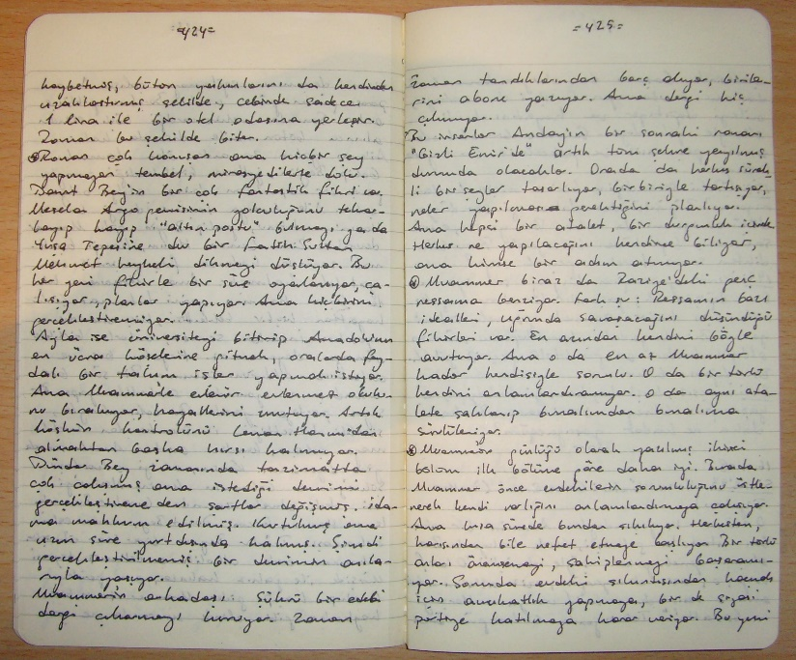
Sketching
Compress a massive object to a small sketch
Objects: high-dimensional vectors, matrices, graphs
Similarity search, compressed sensing, numerical linear algebra
Dimension reduction (Johnson, Lindenstrauss 1984): random projection on a low-dimensional subspace preserves distances
d
n
When is sketching possible?

Slide 3
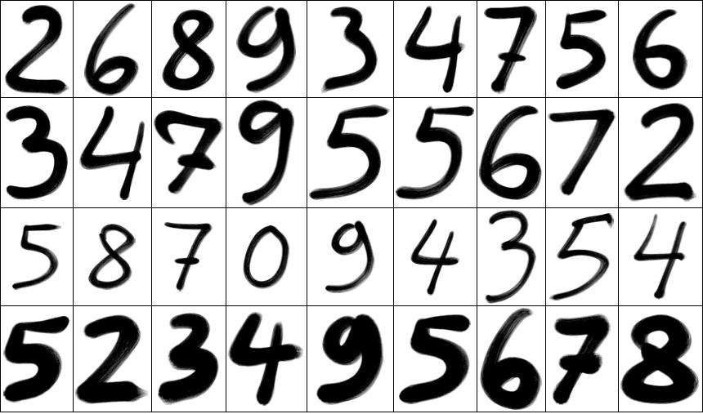
Similarity search
Motivation: similarity search
Model similarity as a metric
Sketching may speed-up computation and allow indexing
Interesting metrics:
Euclidean
Manhattan, Hamming
$ℓ_{p}$ distances
Edit distance, Earth Mover’s Distance etc.

Slide 4
Sketching metrics
0
1
1
0
…
1
Alice and Bob each hold a point from a metric space, x and y
Both send $s$-bit sketches to Charlie
For $r>0$ and $D>1$ distinguish
$d(x, y)≤r$
$d(x, y)≥Dr$
Shared randomness, allow 1% probability of error
Trade-off between $s$ and $D$
Alice
Bob
$$x$$
$$y$$
sketch($x$)
sketch($y$)
Charlie
$d(x, y) ≤ r$ or
$d(x, y) ≥ Dr$ ?

Slide 5
Sketches $⇒$ Near Neighbor Search
Near Neighbor Search (NNS):
Given $n$-point dataset $P$
A query $q$ within $r$ from some data point
Return any data point within $Dr$from $q$
Sketches of size $s$ imply NNS with space $n^{O\left(s\right)}$ and a 1-probe query
Polynomial space whenever $s=O(1)$

Slide 6
Sketching $ℓ_{p}$ norms
[Kushilevitz-Ostrovsky-Rabani’98]: can sketch Hamming space
[Indyk’00]: can sketch $ℓ_{p}$ for $0<p≤2$ via random projections using p-stable distributions
For $D=1+ε$ one gets $s=O(1/ε2)$
Tight by [Woodruff 2004]
For $p>2$ sketching $ℓ_{p}$ is somewhat hard (Bar-Yossef, Jayram, Kumar, Sivakumar 2002), (Indyk, Woodruff 2005)
To achieve $D=O(1)$ one needs sketch size to be $s =\tilde{Θ}\left(d^{1−2/p}\right)$

Slide 7
The main question
Which metrics can we sketch with constant sketch size and approximation?

Slide 8
Beyond $ℓ_{p}$ norms: embeddings
A map f: X → Y is an embedding with distortion C, if for a, b from X:
d_{X}(a, b) / C ≤ d_{Y}(f(a), f(b)) ≤ d_{X}(a, b)
Reductions for geometric problems
f
f(a)
Sketches of size s and approximation D for Y
Sketches of size s and approximation CD for X
a
X
Y
f
b
f(b)

Slide 9
Metrics with good sketches: summary
A metric X admits sketches with s, D = O(1), if:
X = ℓ_{p} for p ≤ 2
X embeds into ℓ_{p} for p ≤ 2 with distortion O(1)
Are there any other metrics with efficient sketches?
We don’t know!

Slide 10
The main result
If a normed space $X$ admits sketches of size $s$ and approximation $D$, then for every ε > 0 the space $X$ embeds into $ℓ_{1−ε}$ with distortion $O(sD / ε)$
Embedding into ℓ_{p}, p ≤ 2
A normed space: R^{d} equipped with a metric Examples: $ℓ_{p}$’s, matrix norms (spectral, trace), EMD
(Kushilevitz, Ostrovsky, Rabani 1998)
(Indyk 2000)
For norms
Efficient sketches

Slide 11
Application: lower bounds for sketches
Convert non-embeddability into lower bounds for sketches in a black box way
No embeddings with distortion O(1) into ℓ_{1 – ε}
*in fact, any communication protocols
No sketches* of size and approximation O(1)

Slide 12
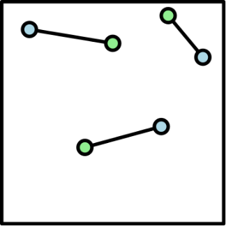
Example 1: the Earth Mover’s Distance
For $x:\left[Δ\right]×[Δ]→R$ with zero average, $||x||_{EMD}$ is the cost of the best transportation of the positive part of $x$ to the negative part
Initial motivation for this work
Upper bounds: [Charikar’02, Indyk-Thaper’03, Naor-Schechtman’05, [A.-Do Ba-Indyk-Woodruff’09]
Lower bound also holds for the minimum-cost matching metric on subsets
No embedding into $ℓ_{1−ε}$ with distortion O(1)
[Naor-Schechtman’05]
No sketches with D = O(1) and s = O(1)

Slide 13
Example 2: the Trace Norm
For an n × n matrix A define the Trace Norm (the Nuclear Norm) ‖A‖ to be the sum of the singular values
Previously: lower bounds only for certain restricted classes of sketches [Li-Nguyen-Woodruff’14]
Any embedding into $ℓ_{1}$ requires distortion $Ω\left(\sqrt{n}\right)$ (Pisier 1978)
Any sketch must satisfy $sD=Ω\left(\frac{\sqrt{n}}{log n}\right)$

Slide 14
The sketch of the proof
Linear embedding of X into ℓ_{1-ε}
[Aharoni-Maurey-Mityagin 1985],
Fourier analysis
Good sketches for X
$g:X→ℓ_{2}$ s.t.
$$L\left(||x_{1}−x_{2}||_{X}\right)≤||g\left(x_{1}\right)−g\left(x_{2}\right)||≤U(||x_{1}−x_{2}||_{X})$$
$L$ and $U$ are non-decreasing,
$L(t)>0$ for $t>0$
$U(t)→0$ as $t→0$
Uses that X is a norm
Good sketches for ℓ∞(X)
Uniform embedding $g$ of X into ℓ₂
[Johnson-Randrianarivony 2006], Lipschitz extension
‖$||(x1, x2, …, xk)||$= max_{i} $||x_{i}||$
[A-Jayram-Pătraşcu 2010],
Direct sum for Information Complexity
$||x_{1}−x_{2}||≤1 ⇒ ||f\left(x_{1}\right)−f\left(x_{2}\right)||≤1$
$||x_{1}−x_{2}||≥sD⇒||f\left(x_{1}\right)−f\left(x_{2}\right)||≥10$
Absence of certain Poincaré-type inequalities on X
Weak embedding $f$ of X into ℓ₂
Convex duality + compactness

Slide 15
Open problems
Can one strengthen our theorem to “sketches with O(1) size and approx. imply embedding into ℓ₁ with distortion O(1)”?
Equivalent to an old open problem from Functional Analysis [Kwapien 1969]
Extend to a more general class of metrics (e.g., Edit Distance?)
Other regimes: what about super-constant $s,D$ ?
Linear sketches with $f(s)$ measurements and $g(D)$ approximation?

