Slide 1
Error Back-Propagation
The following animated slides illustrate how when you are holding your pool cue at the wrong angle, you can reason backwards to improve the angle.
That’s the most basic intuition behind backprop (otherwise known as automatic differentiation).
Ves Stoyanov made the slides. You can watch Jason Eisner present them around 23:00 of this video. They were originally part of this talk.
This work is licensed under a Creative Commons Attribution 4.0 International License.

Slide 2
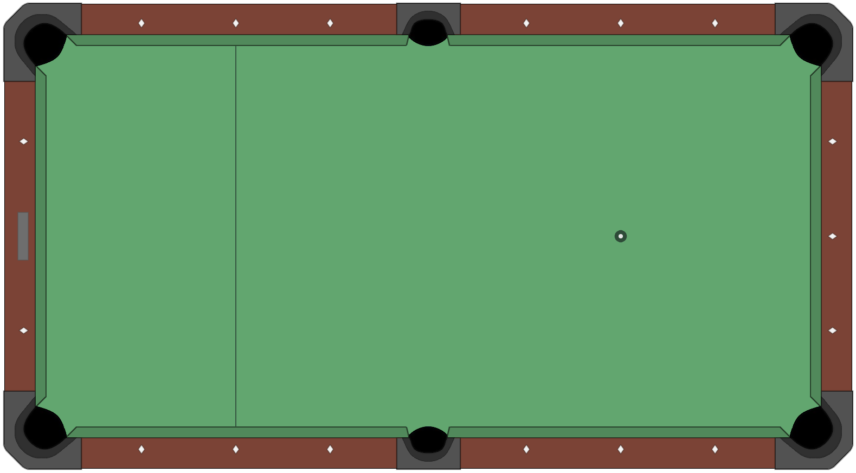
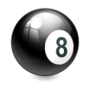
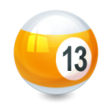
Error Back-Propagation
This work is licensed under a Creative Commons Attribution 4.0 International License.

Slide 3
Error Back-Propagation
This work is licensed under a Creative Commons Attribution 4.0 International License.

Slide 4
Error Back-Propagation
This work is licensed under a Creative Commons Attribution 4.0 International License.

Slide 5
Error Back-Propagation
This work is licensed under a Creative Commons Attribution 4.0 International License.

Slide 6
Error Back-Propagation
This work is licensed under a Creative Commons Attribution 4.0 International License.

Slide 7
Error Back-Propagation
This work is licensed under a Creative Commons Attribution 4.0 International License.

Slide 8
Error Back-Propagation
This work is licensed under a Creative Commons Attribution 4.0 International License.

Slide 9
Error Back-Propagation
This work is licensed under a Creative Commons Attribution 4.0 International License.

Slide 10
Error Back-Propagation
This work is licensed under a Creative Commons Attribution 4.0 International License.

