Slide 1
User Modeling in Language Learning with Macaronic Texts
Adithya Renduchintala
Rebecca Knowles
Philipp Koehn
Jason Eisner
Notes:
Good Afternoon,
My name is Adithya Renduchintala – I’m a phd student at the center for language and speech proc at JHU
I was done in collaboration with RK, PK, and JE.
I am going to present my paper titled “User Modeling in language learning with macaronic texts”
… (next)

Slide 2
The German BookSeller’s Peace Prize was awarded to Navid Kermani in June last year. Navid Kermani was geboren in Germany. He started his career as a reporter for a popular newspaper. Later he studied philosophy, drama and oriental studies…
Notes:
Imagine you are reading an article in a newspaper or a magazine.. Something like this..
This is an example about how a famous writer just won an award.. (next

Slide 3
The German BookSeller’s Peace Prize was awarded to Navid Kermani in June last year. Navid Kermani was geboren in Germany. He started his career as a reporter for a popular newspaper. Later he studied philosophy, drama and oriental studies.
Notes:
)and you encounter some unknown word
How do we proceed?
Todo: introduce the notion of “immersion” you will use it in the next slide.

Slide 4
The German BookSeller’s Peace Prize was awarded to Navid Kermani in June last year. Navid Kermani was geboren in Germany. He started his career as a reporter for a popular newspaper. Later he studied philosophy, drama and oriental studies.
Notes:
Its almost automatic that we try and look at the context to figure out what the unknown word means…
Over time we learn this new word.. This is a example of learning by immersion.. Also called language immersion, or incidental learning…
(next)

Slide 5
Lernen by Immersion
We know this works to acquire L1 (native)

Slide 6
Lernen by Immersion
We know this works to acquire L1
We also know this to work to acquire L2 (second language)
“It is widely agreed that much second language vocabulary learning occurs incidentally while the learner is engaged in extensive reading.” (Huckin & Coady, 1999)

Slide 7
Lernen by Immersion
Some obvious problems…
If you want to learn German
start reading German!

Slide 8
Lernen by Immersion
Some obvious problems…
If you want to learn German
start reading German!
Some obvious problems…

Slide 9
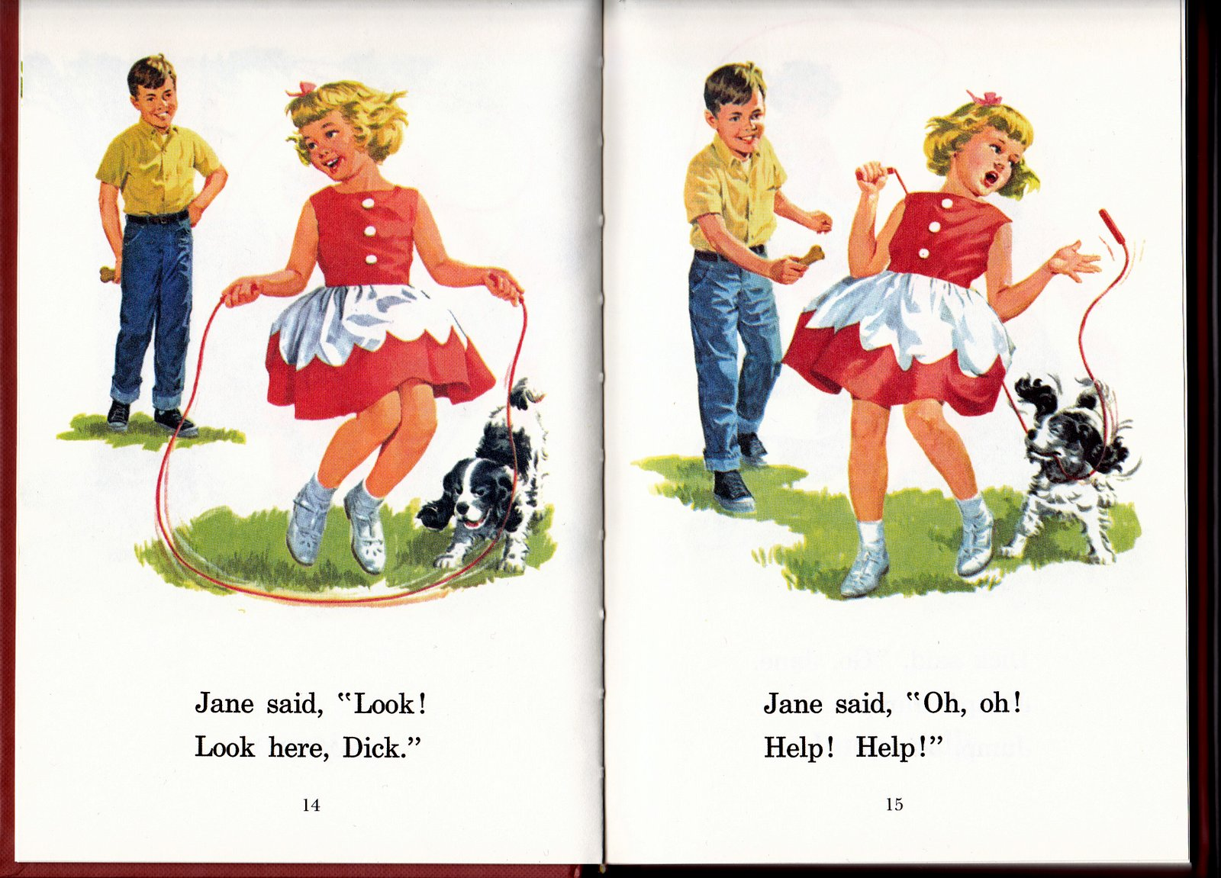
Lernen by Immersion
Start reading German!
Notes:
all you'll be able to read at first is Dick & Jane, which, by the way, is why learning a foreign language in high school is so frustrating

Slide 10
Lernen by Immersion
Start reading German!
Notes:
all you'll be able to read at first is Dick & Jane, which, by the way, is why learning a foreign language in high school is so frustrating

Slide 11
Lernen by Immersion
Can we leverage mixing L1 and L2 to learn new L2 vocabulary?
Notes:
So we are asking how we can put a new spin on immersion via reading…
--- can we use mixed language to learn a new language.
We believe the answer is yes. (next)

Slide 12
Lernen by Immersion
Navid Kermani was geboren in Germany.
Notes:
If fact for those of you who knew no German before this talk … you know at least one word now…

Slide 13
Lernen by Immersion
Navid Kermani was geboren in Germany.
Notes:
Actually 2 words.. For those who are paying close attention – even the title is mixed…
We refer to this mixing as macaronic text.

Slide 14
Macaronic Text
Macaronic:
Of or containing a mixture of vernacular words with Latin words or with vernacular words given Latinate endings: macaronic verse.
Of or involving a mixture of two or more languages.
Like code-switching but more deliberate and often for humor.
Notes:
Inspired by the idea of engineering the mixing of language for the particular motive:
we are “engineering” these sentences with the goal of teaching/learning.
Unlike code-switching….

Slide 15
Research Goal
We want to investigate macaronic immersion as a tool for language learning.

Slide 16
System: Components
Notes:
Our setup for such a system is as follows:
It is driven by 2 main components.
(next)

Slide 17
System: Components
Generate a spectrum of macaronic content.
Notes:
1st component: A methodology to generate macaronic sentences in a flexible way, automatically, preferably with little or no human editing.
What would this look like in the wild? What would this feel like to a learner? Is merely presenting text adequate?
We developed an interface to investigate these questions: I’m going to give a quick demo..
(next)

Slide 18
System: Components
Demonstration of Macaronic Interface

Slide 19
System: Components
Completely in English
Komplett in Deutsch!

Slide 20
System: Components
Model the learner and present content to their level.
Notes:
The 2nd component is user modeling. Can we use our methodology for generating macaronic texts with a wide verity of content
-- maybe content selected by the learner himself…
-- and make that content instructional material…
That is take arbitrary content and turn it into macaronic text at the CORRECT LEVEL FOR A SPECIFIC USER.
When we talk about correct level for a user -> we must address user comprehension of a macaronic sentence… this is what we will discuss next…
(next)

Slide 21
Modeling Learner Comprehension
The
police
verhaftete
the
bank
robber
Notes:
Lets start by looking at a relatively simple example of a macaronic sentence.
And try and figure out how a naïve learner might try and guess the meaning of ‘verhaftete’
(next)

Slide 22
Modeling Learner Comprehension
Verified?
The
police
verhaftete
the
bank
robber
Notes:
One option for the learner is to go simply by the way the unknown word ‘appears’.. So they completely ignore the rest of the sentence ..
(its not the best strategy.. But it is possible)
- If you were to use this strategy you might guess ‘verified’ as the meaning…

Slide 23
Modeling Learner Comprehension
Verified?
The
police
verhaftete
the
bank
robber
Notes:
How can our model imitate this behavior?
We can imitate this by engineering the factor appropriately..
(next)

Slide 24
Modeling Learner Comprehension
English Guess – Foreign Word Factor
‘EF’ Factor
Verified?
The
police
verhaftete
the
bank
robber
Notes:
First lets name the factor…
The factor connects the english guess to a observed foreign word..
EF Factor for short
We assign a log-linear model which we all know and love!
Lets be consistent with the notation ..
(next)

Slide 25
Modeling Learner Comprehension
English Guess – Foreign Word Factor
‘EF’ Factor
Verified?
The
police
verhaftete
the
bank
robber
Notes:
Nothing has changed we are just naming the variables with ‘ef’
(next)

Slide 26
Modeling Learner Comprehension
English Guess – Foreign Word Factor
‘EF’ Factor
Verified?
Orthographic Similarity (e, f)
Pronunciation Similarity (e, f)
…
The
police
verhaftete
the
bank
robber
Notes:
Phi ef is the feature function…
It takes the e word and the f word and returns scores here we encode scores that are based on orthographi similarity and pronunciation similarity
(next)

Slide 27
Modeling Learner Comprehension
English Guess – Foreign Word Factor
‘EF’ Factor
Verified?
Weights
Orthographic Similarity (e, f)
Pronunciation Similarity (e, f)
…
The
police
verhaftete
the
bank
robber
Notes:
And of course its associated weights..
(next)

Slide 28
Modeling Learner Comprehension
arrested?
The
police
verhaftete
the
bank
robber
Notes:
But a user might (and ideally should) take into account the rest of the sentence…
And that might make them change their mind about what the word means… in this example they now might think ‘arrested’ might be a better fit

Slide 29
Modeling Learner Comprehension
The
police
arrested
the
bank
robber
The
police
verhaftete
the
bank
robber
Notes:
- We can accommodate such guesses but adding these factors to our model..
Now the rest of the english words influence the guess.
(next)

Slide 30
Modeling Learner Comprehension
The
police
arrested
the
bank
robber
English–English Factor
‘EE’ Factor
The
police
verhaftete
the
bank
robber
Notes:
So ever time a macaronic sentence is presented to a learner they are placing a distribution over words and presumably picking the best word…
(next)

Slide 31
Modeling Learner Comprehension
The
police
arrested
the
bank
robber
English–English Factor
‘EE’ Factor
The
police
verhaftete
the
bank
robber
Notes:
So ever time a macaronic sentence is presented to a learner they are placing a distribution over words and presumably picking the best word…
\phantom
(next)

Slide 32
Modeling Learner Comprehension
The
police
arrested
the
bank
robber
English–English Factor
‘EE’ Factor
The
police
verhaftete
the
bank
robber
PMI of e_{i}, e_{j} at distance =1
PMI of e_{i}, e_{j} at distance >1
Notes:
So ever time a macaronic sentence is presented to a learner they are placing a distribution over words and presumably picking the best word…
(next)

Slide 33
Modeling Learner Comprehension
The
police
arrested
the
bank
robber
English–English Factor
‘EE’ Factor
The
police
verhaftete
the
bank
robber
weights
PMI of e_{i}, e_{j} at distance =1
PMI of e_{i}, e_{j} at distance >1
Notes:
So ever time a macaronic sentence is presented to a learner they are placing a distribution over words and presumably picking the best word…
(next)

Slide 34
Modeling Learner Comprehension
The
??
arrested
the
bank
robber
The
Polizei
verhaftete
the
bank
robber
Notes:
Ok so far we only considered the case where ONE english word is hidden… but what if more that 1 word is hidden? (its flexibly macaronic after all!!)
So what if they did not have access to the observed word “police”
(next)

Slide 35
Modeling Learner Comprehension
The
arrested
the
bank
robber
The
Polizei
verhaftete
the
bank
robber
Notes:
So ever time a macaronic sentence is presented to a learner they are placing a distribution over words and presumably picking the best word…
(next)

Slide 36
Modeling Learner Comprehension
The
arrested
the
bank
robber
The
Polizei
verhaftete
the
bank
robber
Notes:
So ever time a macaronic sentence is presented to a learner they are placing a distribution over words and presumably picking the best word…
(next)

Slide 37
Modeling Learner Comprehension
The
police
arrested
the
bank
robber
The
Polizei
verhaftete
the
bank
robber
Notes:
So ever time a macaronic sentence is presented to a learner they are placing a distribution over words and presumably picking the best word…
(next)

Slide 38
Modeling Learner Comprehension
Unobserved English words
Observed English words
Observed Foreign words
EE Factor
Contextual Influence
EF Factor
Similarity of e and f
Notes:
Which models the posterior probability for the START ANIMATION!!

Slide 39
Modeling Learner Comprehension
We just built a model to jointly translate the German words in context.
To get “best” prediction accuracy:
Add better features, dictionaries, MT system, …
To match a naïve human’s guesses:
Use only features available to naïve humans.
Train to match “actual” human guesses
Notes:
(do the points animation first)
What we have is actually a cognitive model of a naïve human, which takes the from of a well-known ML algorithm.
And THAT is what we are training…

Slide 40
Modeling Learner Comprehension
So how do we get the training data?
Demo of Data Collection.

Slide 41
Modeling Learner Comprehension
Note on history features
History+

Slide 42
Modeling Learner Comprehension
Note on history features
History+
History-

Slide 43
Modeling Learner Comprehension
Loopy Belief Propagation for Inference
3 iterations in Loopy cases
Single iteration of message passing with <= 2hidden variables
Tree-Like message passing schedule (Dryer & Eisner 2009)
Optimization using SGD
L2 Regularization
3 Epochs
learning rate 0.1
regularization 0.2
Parallelized using Hogwild! Algorithm (Recht et al 2011)

Slide 44
Preliminary Results
6K, 2K, 2K train, dev and test instances
English Vocabulary Size 5K types
German Vocabulary Size 639 types
Top K | Recall at K
1 | 16.14
25 | 35.56
50 | 40.30

Slide 45
Alternate Evaluation?
The policeman verhaftete the bank robber.
Notes:
A key point here is that the model’s prediction is a distribution over the entire English vocabulary.

Slide 46
Alternate Evaluation?
Reference
arrested
The policeman verhaftete the bank robber.
Notes:
A key point here is that the model’s prediction is a distribution over the entire English vocabulary.

Slide 47
Alternate Evaluation?
Model’s Predictions
chased -1.210
arrested -1.6034
shot -3.3206
verified -5.552
…
arrested
The policeman verhaftete the bank robber.
Notes:
A key point here is that the model’s prediction is a distribution over the entire English vocabulary.

Slide 48
Alternate Evaluation?
User’s Guess
chased -1.210
arrested -1.6034
shot -3.3206
verified -5.552
…
caught
arrested
The policeman verhaftete the bank robber.
Notes:
A key point here is that the model’s prediction is a distribution over the entire English vocabulary.

Slide 49
Sim(chased, arrested)
Sim(caught ,arrested)
User-reference
similarity
Model-reference
similarity
User’s Guess

Slide 50
Model’s
Prediction
Sim(chased, arrested)
Sim(caught ,arrested)
User-reference
similarity
Model-reference
similarity
Notes:
Todo: better colors…

Slide 51
Sim(chased, arrested)
Sim(caught ,arrested)
User-reference
similarity
Reference
Model-reference
similarity
Used cosine similarity for “Sim” function with pre-trained GLoVe word embeddings

Slide 52
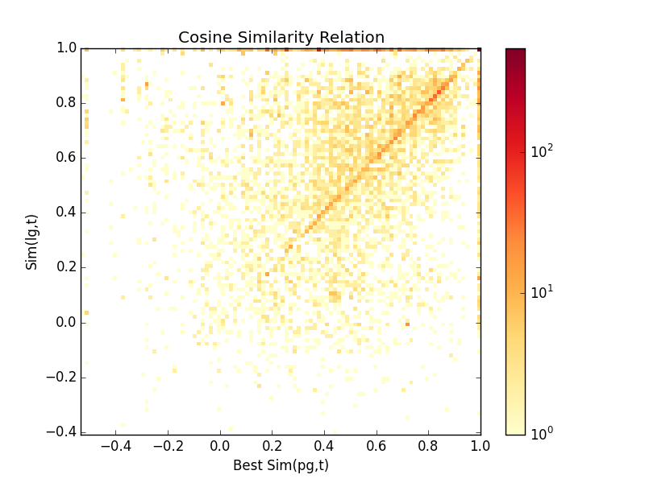
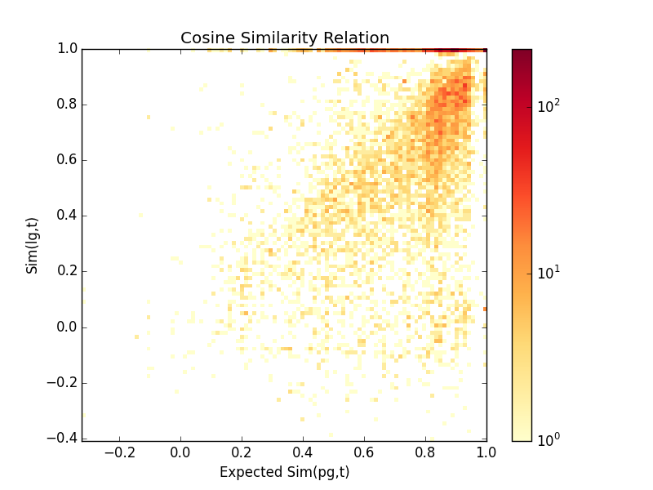
Preliminary Results
User-ref
similarity
Expected
Model-ref
similarity
Model-ref
similarity
Quality Corr=0.379
Quality Corr=0.525
Notes:
So now correlation is a good way to measure our model taking into account that exact matches are do not convey the whole story.

Slide 53
User Learning Styles
Also trained a user-adapted model.
79 different users in our data pool.
Learned 6 basic feature weights with 79 x 6 user adapted feature weights
Hal Daume III. Frustratingly easy domain adaptation. In Proceedings of ACL, pages 256–263, June 2007
Notes:
Another experiment we did was to see if we can discern anything on how certain learners go about this task.
We trained a user-adapted model which is basically learning a conjunction of the base features for each user.
So we end up with 79 times 6 feature weights..

Slide 54
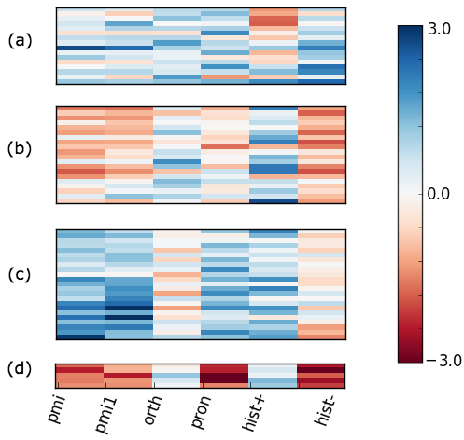
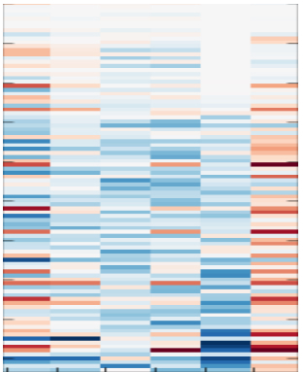
User Learning Styles
Each row represents
the feature weights for
a specific user.

Slide 55
User Learning Styles
Columns are feature
weights.

Slide 56
User Learning Styles
PMI @1 and PMI >1
Feature weights

Slide 57
User Learning Styles
Similarity Feature
weights

Slide 58
User Learning Styles
History Feature
weight

Slide 59
User Learning Styles
Clustered users
Into 4 groups.

Slide 60
User Learning Styles
Using all the features to a similar degree
(A)
Using positive history and orthography but also some context
(B)
Using context, pronunciation and history!
(C)
Just seem to memorize a few words, only using orthography
(D)

Slide 61
User Learning Styles
Using all the features to a similar degree
(A)
Using positive history and orthography but also some context
(B)
Using context, pronunciation and history!
(C)
Just seem to memorize a few words, only using orthography
(D)

Slide 62
User Learning Styles
Using all the features to a similar degree
(A)
Using positive history and orthography but also some context
(B)
Using context, pronunciation and history!
(C)
Just seem to memorize a few words, only using orthography
(D)

Slide 63
User Learning Styles
Using all the features to a similar degree
(A)
Using positive history and orthography but also some context
(B)
Using context, pronunciation and history!
(C)
Just seem to memorize a few words, only using orthography
(D)

Slide 64
Recap
General Problem:
Build automated systems to deliver personalized content at the appropriate macaronic level to a learner.
Sub-problem:
Build a model to estimate a learner’s comprehension of a macaronic sentence.

Slide 65
Open Challenges
YOU ARE HERE!

Slide 66
Open Challenges
YOU ARE HERE!
Syntax

Slide 67
Open Challenges
YOU ARE HERE!
Morphology
Syntax

Slide 68
Open Challenges
YOU ARE HERE!
Morphology
Learning over time
Syntax

Slide 69
Open Challenges
YOU ARE HERE!
Morphology
Learning over time
Planning & Reinforcement Learning
Syntax

Slide 70
Open Challenges
YOU ARE HERE!
Online updates of user model
Morphology
Learning over time
Planning & Reinforcement Learning
Syntax

Slide 71
Open Challenges
YOU ARE HERE!
Online updates of user model
Morphology
User Interaction & HCI issues
Learning over time
Planning & Reinforcement Learning
Syntax

Slide 72
Thank you!

Slide 73
Related Works at ACL
Demo session:
“Creating Macaronic Interfaces for Language Learning”
5:30 – 7:00 pm Today!
Maritim Hotel
Companion paper:
“Analyzing Learner Understanding of Novel L2 Vocabulary”
2 – 3:40 pm, Thursday
Room: 2.094
Notes:
Todo: check

