Slide 1
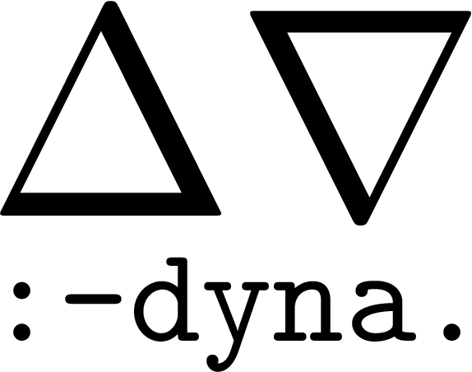
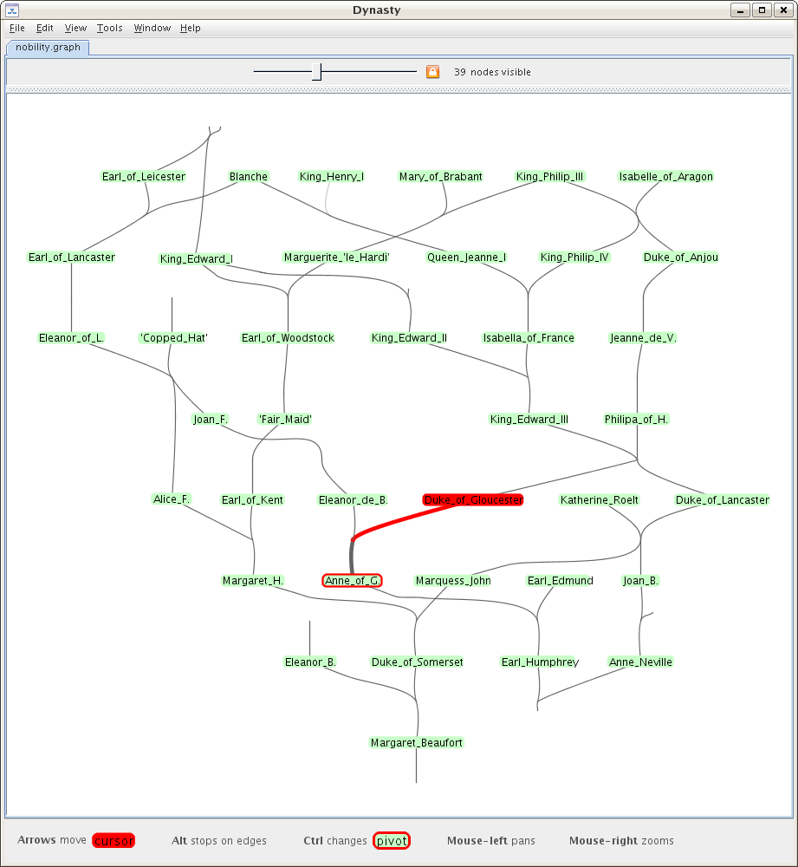
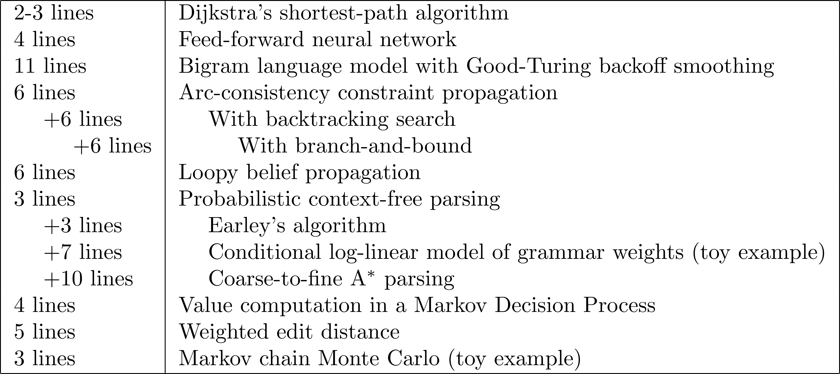
Treating Machine Learning Applications As Declaratively Specified Circuits
Faster to implement
Jason Eisner, Nathaniel Wesley Filardo, Matthew Francis-Landau, Tim Vieira
PL
ML
PL Helping ML: The Abstraction Challenge
COMPLEXITY IN ML SYSTEMS: The complexity of modern ML systems interferes with research, development, and education. It is a truism that an experiment that is casually suggested by a research advisor, and seems to be straightforward, may cost six months before an efficient and (hopefully) bug-free implementation is actually running.
ABSTRACTION IS KEY: Textbook algorithms may appear relatively simple because they can be written at an abstract level — e.g., as update rules on a small set of nicely notated mathematical quantities. However, applying such an algorithm to a real-world problem means instantiating those abstract quantities in terms of problem-specific data structures that must be efficiently and correctly manipulated.
EFFICIENCY AND PORTABILITY: Worse, a typical applied ML system combines several of these techniques, so that many types of quantities are interacting. Not only does this increase complexity, but it creates a pressure to optimize across the abstraction boundaries in order to maintain speed. Choosing among possible optimizations is challenging and time-consuming, involving questions such as multiple-use data structures, time-space tradeoffs, loop orders, and use of specialized libraries and hardware. Implementing these optimizations further increases the complexity and risks bugs, particularly as the system evolves during research and development.
Faster execution
ML Helping PL: The Systems Challenge
We have two protoypes of earlier versions of the language
Dyna 1 prototype (2005) was used for 17 dynamic programming research papers
Dyna 2 prototype (2013) was used for teaching an NLP course to linguists with no programming background.
Both were inefficient because they used too many one-size-fits-all strategies.
Can we build an auto-tuning system? Or can you?
Fulfills the promise of declarative program specification!
Flexible Solver Architecture
Tasks on agenda can be executed in any order!
Interpolates between eager and lazy strategies
% matrix multiplication
a(I,K) += b(I,J) * c(J,K).
Task:
Compute a(I,4)for all I
agenda
choose!
Tons of admissible strategies. Each attempts to make progress towards an answer to open queries
Dyna
Dyna is a high-level “circuit programming” language
Declarative semantics: fixpoint of a circuit
can be infinitely wide, infinitely deep
allows cycles
dynamic data-dependent structure
Prolog-like rules … very concise!
Innovative typing and inheritance/modularity features
queries &
updates
pop
task
choose!
Memos are optional.
Solver can create or flush memos anytime.
(memos save recomputation, but require maintenance)
push
new
tasks
run
dispatch
Strategy:
for J in c(:,4):
for I in b(:,J):
a(I,4) += b(I,J) * c(J,4)
choose!
strategy
cache
memoize
computed
values
response
lookup
thread
Strategy options
Solver should systematize all the reasonable implementation tricks that programmers might use and make them work together correctly.
Parallelizing independent computations
Ordering dependent computations
Join strategies
Forward vs. backward chaining (update-driven vs. query-driven)
Dynamically identify unnecessary computation
Short-circuiting, branch-and-bound/A*, watched variables
Consolidating related work
Static or dynamic batching (consolidating similar tasks, including GPU)
Inlining depth (consolidating caller-callee)
Storage
Memoization policy; choose low-level data structures
Hardware
Partitioning the problem across heterogeneous devices (GPUs, distributed)
Prolog-like Rules Define a Dynamic Computation Graph
a = b * c. % equation
Reactive: a keeps up to date with b and c
b += x. b += y. equivalent to b = x + y. (almost)
c += z(1). c += z(2). c += z(3). c += z("foo").
a(I) = b(I) * c(I). % elem-wise multiplication
a += b(I) * c(I). % dot product (sparse)
a(I,K) += b(I,J) * c(J,K). % matrix mult (sparse)
Shorthand
Reinforcement Learning Objective
c += z(N).
Variable
Total cost knob setting
Average latency on workload
Encourage earlier jobs to finish first
urgency
Train by actor-critic with fast RLDT actor
knob settings
Running the Policy
edge(…) query
edge(x,Y) for some x
answer will be an iterator over outgoing edges (adjacency list)
hash(x)/H ≤ 0.2
look up answer in dense array A4 indexed by x (where x is an integer or is represented as one)
Real-World Examples
…
edge(x,y)
z
…
edge(X,Y)
…
otherwise
`
look for answer in sparse hash table H5
cached
return answer
Shortest path:
distance(V) min= distance(U) + edge(U,V).
rand() ≤ 0.3
answer from edge rules using join strategy 1
otherwise
query edge(X,Y) and filter to X=x
otherwise
join strategy 2
Probabilistic Context-free parsing
phrase(X,I,K) += word(W,I,K) * rewrite(X,W).
phrase(X,I,K) += phrase(Y,I,J) * phrase(Z,J,K)
* rewrite(X,Y,Z).
result = phrase("s", 0, sentence_length).
…
rand () ≤ 0.1
otherwise
Policy probabilities that are tuned over time (typically approaching 0 or 1)
return answer
memoize & return
References and Further Reading
General Neural Network
$σ$(X) = 1 / (1 + exp(-X)).
out(J) = $σ$(in(J)).
in(J) += out(I) * edge(I,J).
loss += (out(J) – target(J)) ** 2.
Tim Vieira, Matthew Francis-Landau, Nathaniel Wesley Filardo, Farzad Khorasani, and Jason Eisner. 2017. Dyna: Toward a Self-Optimizing Declarative Language for Machine Learning Applications. MAPL Workshop.
Jason Eisner and Nathaniel W. Filardo. 2011. Dyna: Extending Datalog For Modern AI. In Datalog Reloaded.
Jason Eisner, Eric Goldlust, and Noah A Smith. 2005. Compiling Comp Ling: Practical weighted dynamic programming and the Dyna language. In Proc. of EMNLP.
Nathaniel Wesley Filardo and Jason Eisner. 2012. A Flexible Solver for Finite Arithmetic Circuits. In International Conference on Logic Programming LIPICS.
Nathaniel Wesley Filardo. 2017. Dyna 2: Towards a General Weighted Logic Language. PhD Thesis.
% Convolutional layer in the neural network
edge(input(X,Y),hidden(X+DX,Y+DY)) = convWeight(DX,DY).
convWeight(DX,DY) := random(*,-1,1) for DX:-1..1, DY:-1..1.

